Slide 1
The Data Link Layer
Gihan Dias
CS303- May 2007

Slide 2
Data Link Layer
7
Application
6
Presentation
5
Session
4
Transport
3
Network
2
Data Link
1
Physical

Slide 3
Functions of the DLL
Synchronisation
Error control
Flow control
Data compression
Encryption

Slide 4
Additionally – for Shared Media
Media access control
  control the access of the shared medium by each station
Logical link control
  functions in the previous slide
Why MAC?
- Using the MAC address we can separately identify stations while using Shared Medium without conflicts

Slide 5
Synchronisation
Objective:
  To identify the beginning and end of data
At the data-link layer, data are divided into units
The receiver must be able to distinguish the beginning and end of each unit
We use delimiters to show the boundary between 2 frames

Slide 6
Types of synchronisation
Fixed-length (No need of delimiters)
  byte (e.g., asynchronous transmission)
  Cell
Variable length
  data is divided in to frames

Slide 7
Frame
A link-layer data unit is called a frame, and encapsulates a packet
Frame
header
Frame
trailer
frame (data-link)
data
message (app)
segment (transport)
packet (network)

Slide 8
Frame delimitation
Character count
Character-oriented
  beginning and end of frames are identified by STX and ETX characters
Bit-oriented
  frames are delimited by flag sequence

Slide 9
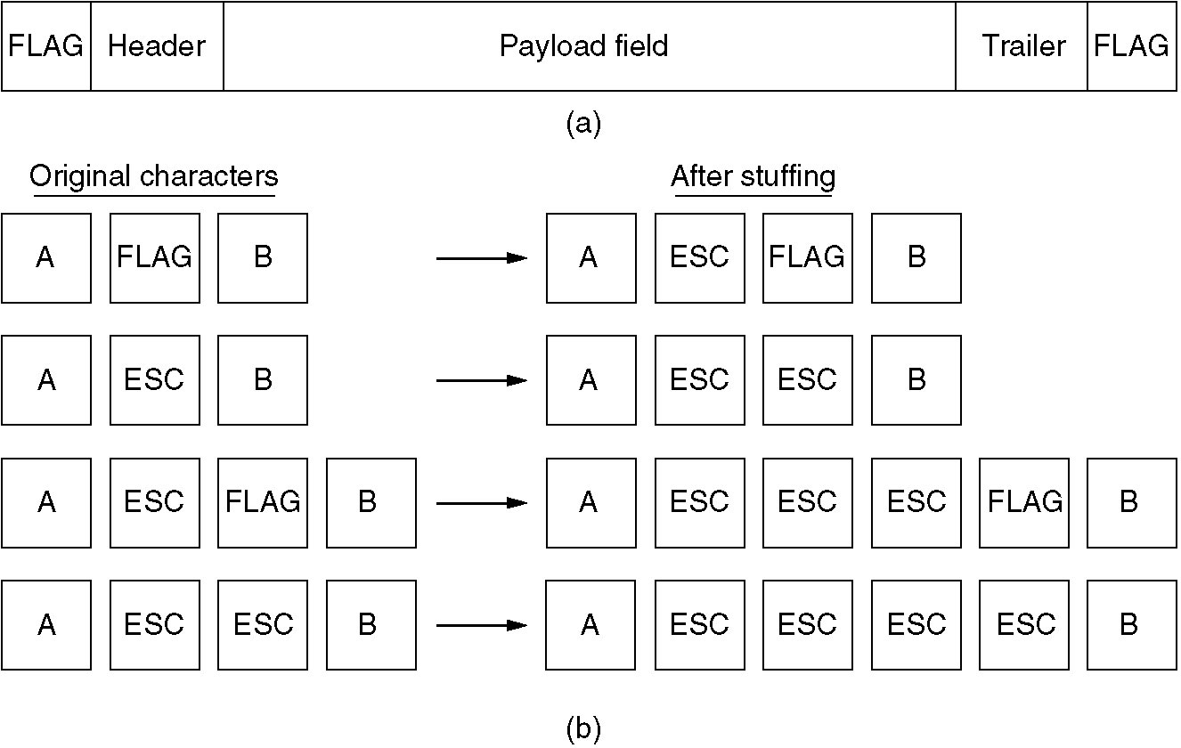
Character-oriented Framing
ESC = “\”
Just like in programming languages
(a) A frame delimited by flag bytes.
(b) Four examples of byte sequences before and after stuffing.

Slide 10
Bit-oriented Framing
Data frame 1:
011100010101111000110
Data frame 1 with flag sequences:
0111111001110001010111100011001111110
Data frame 2:
011100010111111000110
Data frame 2 with stuffed bit:
0111000101111101000110
Data frame 2 with flags:
01111110011100010111110100011001111110

Slide 11
Problems with Synchronisation
Data loss (e.g. ETX or flag)
Data errors
Control char or flag may appear in data

Slide 12
Error Control
Physical transmission may introduce errors
  missing bits
  inserted bits
  changed bits – 1→0, 0 →1
Errors often occur in bursts
Sudden breaks
error
error
error burst

Slide 13
Error Control
We need to
  detect errors
  correct errors or deal with errored data appropriately
  Even we can’t correct, we have to at least detect them

Slide 14
Error Detection
Introduce additional data into frame
  Parity
  Checksum
  Cyclic redundancy check (CRC)
all methods can detect only some errors
residual errors will exist
prob. of residual errors should be low
how to deal with residual errors?

Slide 15
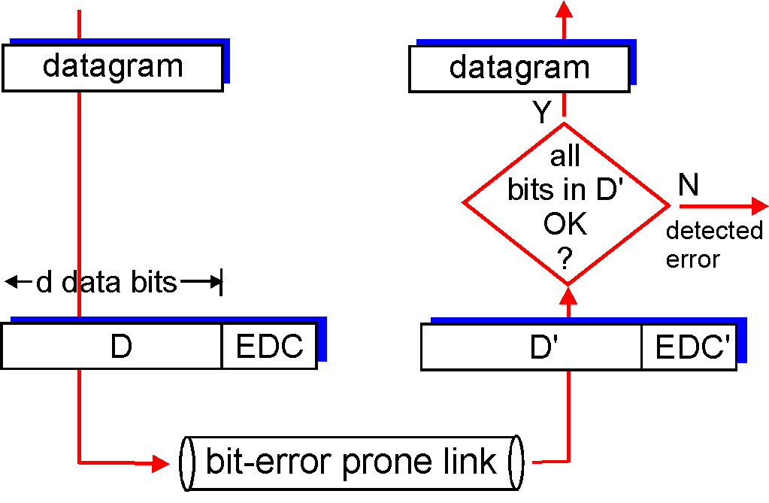
Error Detection
EDC= Error Detection and Correction bits (redundancy)
D = Data protected by error checking, may include header fields

Slide 16
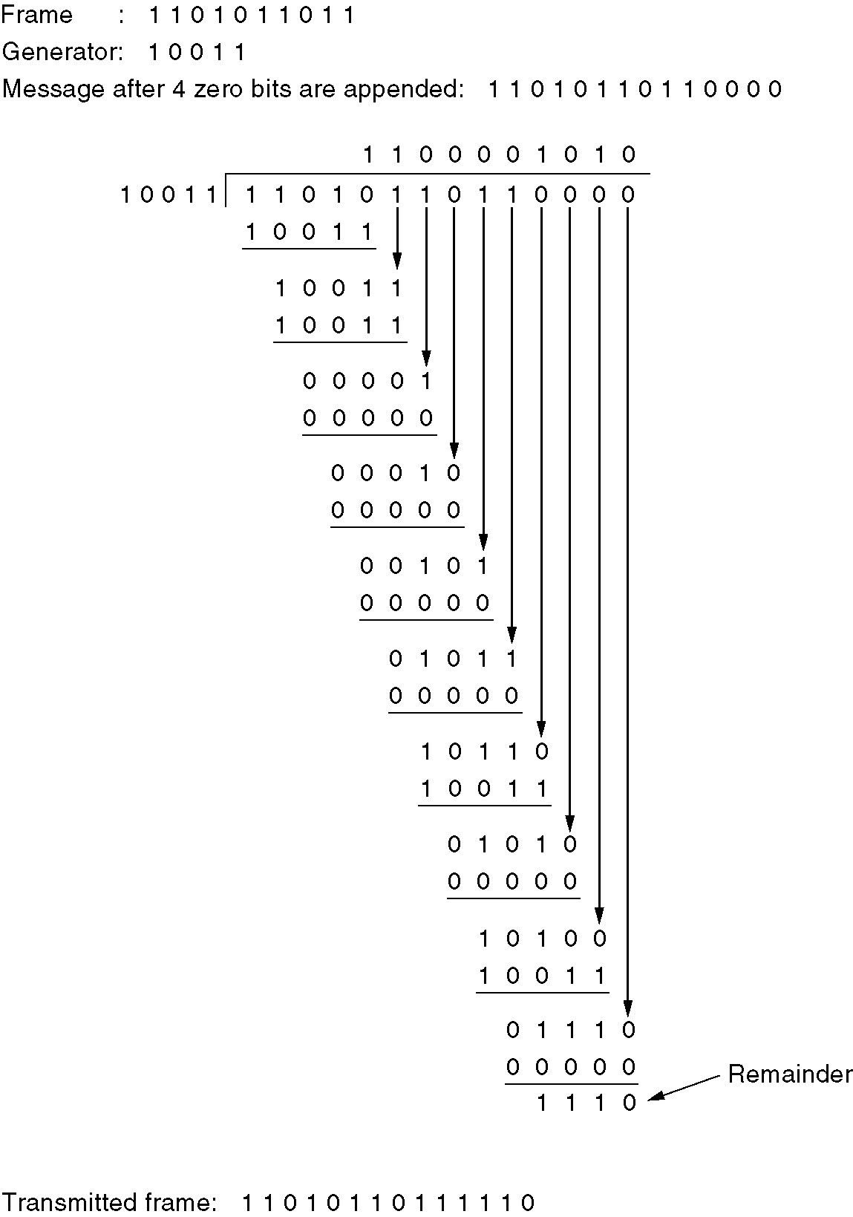
Error-Detecting Codes
Calculation of the
polynomial code checksum.

Slide 17
Error Correction
Forward Error Correction
Automatic Repeat Request (ARQ)

Slide 18
Forward Error Correction
Redundancy is added to data stream
Sufficient to recover original data even if some errors occur
  simplex transmission
  CD-ROMs
  high-latency links
Residual error rate may be high

Slide 19
Forward Error Correction (cont..)
May be used where low latency is more important than low error rate
  e.g. voice, video
the sender sends a redundant error-correcting code along with the data frame. The receiver performs necessary checks based upon the additional redundant bits. If it finds that the data is free from errors, it executes error-correcting code that generates the actual frame. It then removes the redundant bits before passing the message to the upper layer

Slide 20
Automatic Repeat Request -
ARQ
Idle RQ (stop and wait)
  link utilisation may be low
Continuous RQ
  sliding window protocols
Extra – Piggy Bank
Sending some set of data from the previous and the next data sets. So if the previous data are with errors or next, they can be recovered using those extra data.

Slide 21
Idle RQ (stop and wait)
sender
wait
time-out
data
lost
data
re-sent
data
data
ack
ack
x
receiver
2 ways of not going ack

Slide 22
Continuous ARQ
a counter (state variable) is maintained at both ends
  V(S) - send state variable - sequence number of next frame to be sent
  V(R) - receive state variable - sequence number of expected frame
frames are sent with V(S)
ACK is sent with V(R), if frame does not have errors and then sender can free the corresponding frame from the window

Slide 23
Continuous ARQ
if a frame is erroneous, a NAK is sent
  NAK is called Reject or Selective Reject
for V(S) and V(R), a 3-bit field is often used
  8 numbers (000 to 111) - window size is 7
if n bits are send and no ACK comes the sender waits till an ACK comes
No problem in getting more than one same packet until it satisfied with the ack. Duplicates will be discarded after the ack is done

Slide 24
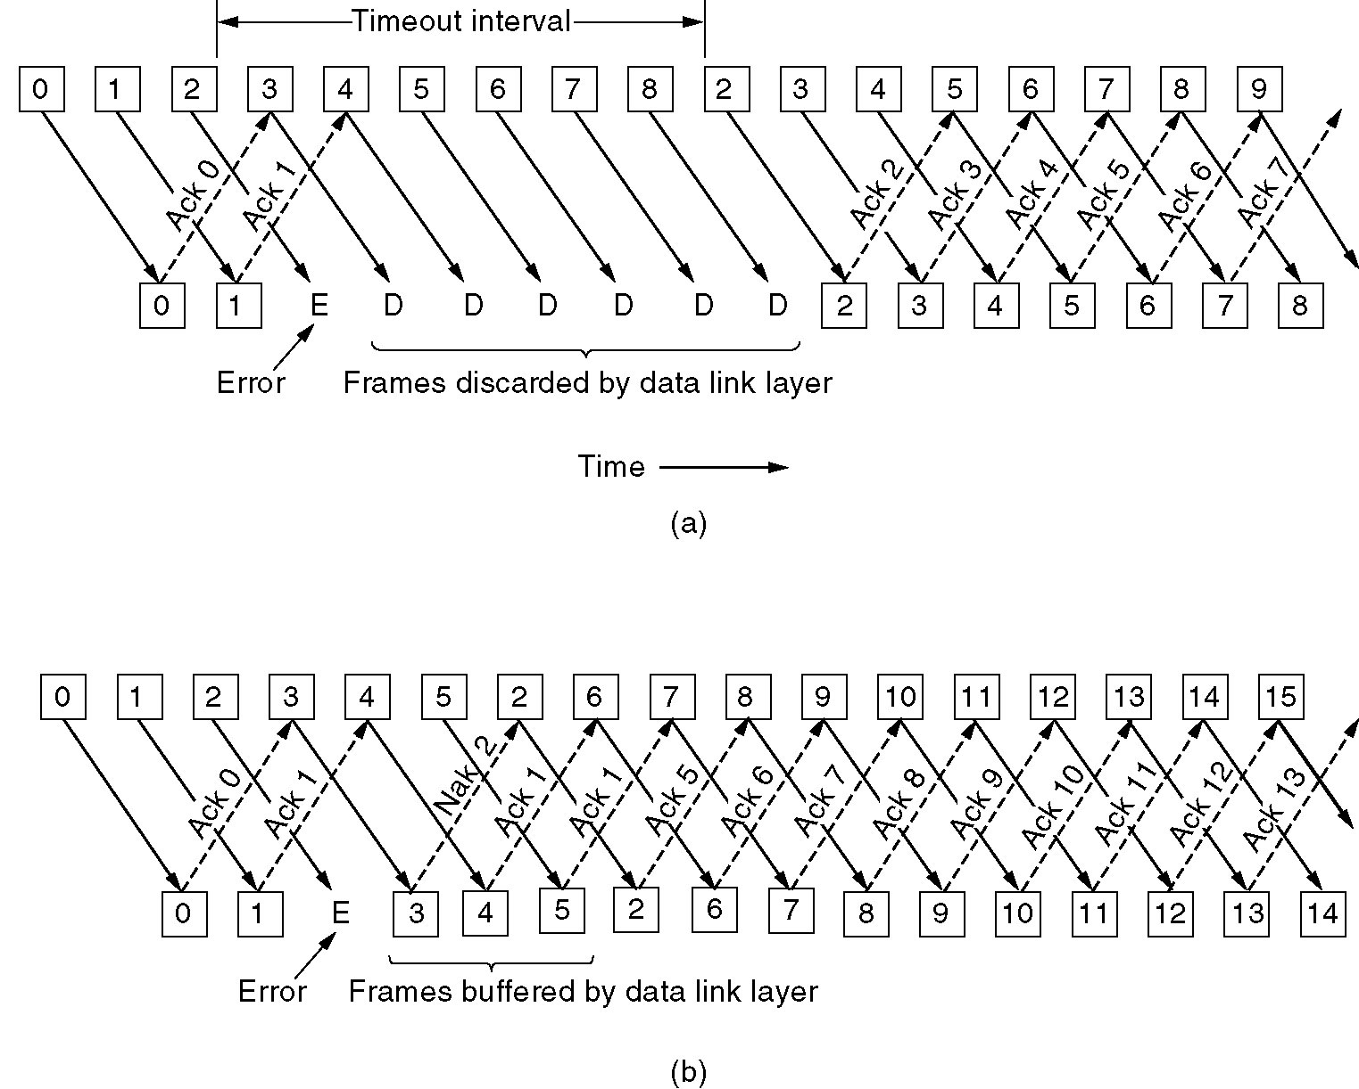
Continuous ARQ (Go Back N)
Keep these data safely. Receiver is capable in collecting many pending data
(a) Receiver’s window size is 1.
(b) Receiver’s window size is large.

Slide 25
Flow control
In-band
  X-ON / X-OFF
Out-of-Band
  CTS / RTS
In conjunction with error control
  by manipulation the size of the sliding window

Slide 26
Data compression
Based on probability theory
Prob of each symbol is unequal
  P(“e”) >> P(“x”)
Prob of next symbol is based on previous ones
  Electroni?

Slide 27
Encryption
Used to Ensure
  Privacy (confidentiality)
  Authenticity
Based on an encryption algorithm and a key
  single-key encryption
  public-key (two-key) encryption

Slide 28
Medium Access Control
Primary / Secondary
Peer-to-peer

Slide 29
Primary / Secondary
Polling
  stop and wait
  continuous ARQ
non-Polling
  RTS/CTS
  Time-Division Multiple Access (TDMA)
When a node wants to transmit data to another node, it sends out a RTS 'Request to Send' packet. The receiver node replies with a packet called CTS 'Cleared to Send' packet.After the transmitter node receives the CTS packet, it transmits the data packets.

Slide 30
Poll/Select Systems
Poll
  Do you have data for me?
Select
  I have data for you and I am selecting you. Can you receive?

Slide 31
Non-polling Systems
RTS/CTS
Widely used since RS-232-C uses the same method
RTS
CTS
Data
CTS Off
Data

Slide 32
TDMA
(Time Division Multiple Access)
used in satellite networks
one site is designated as master (reference) station
when secondary stations wish to use the channel, they indicate that to reference station
reference station periodically transmits control information indicating which station can use the channel during each time-slot

Slide 33
Peer-to-peer
Time Division Multiplexing (TDM)
Aloha
Carrier Sense Multiple Access - CSMA
Token Ring
Token Bus

Slide 34
TDM
Time-Division Multiplexing
simplest of peer to peer
each station is given a pre-assigned time-slot
transmits only in that time-slot
found in both LANs and WANs

Slide 35
ALOHA
A station transmits whenever it has data to send
  there will sometimes be collisions between packets sent by two or more stations
Stations detect the collision and re-transmit
performance degrades when traffic is high

Slide 36
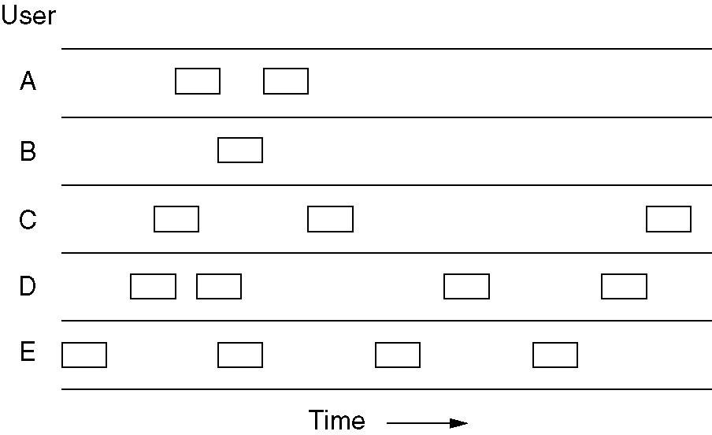
Pure ALOHA
In pure ALOHA, frames are transmitted at completely arbitrary times.

Slide 37
Carrier Sense Multiple Access
CSMA
Each station monitors the channel and transmits only when the channel is free
  collisions may still occur if two stations transmit almost simultaneously

Slide 38
CSMA with collision detection
CSMA-CD
stations monitor channel while transmitting
aborts transmission if it detects a collision
waits a random period of time before re-transmitting
  why a random time?
Otherwise both stations send data again at the same time

Slide 39
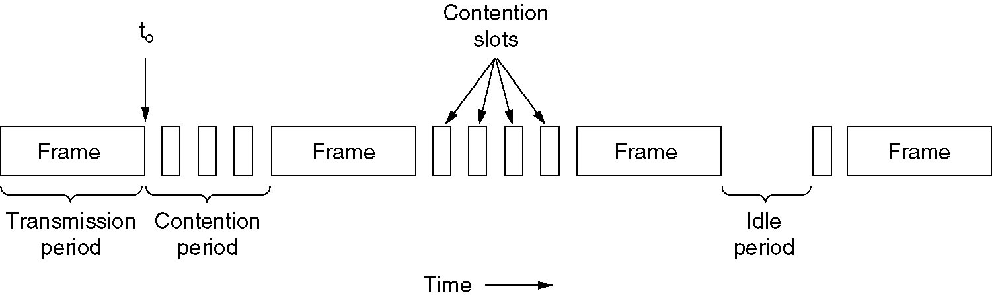
CSMA with Collision Detection
CSMA/CD can be in one of three states: contention, transmission, or idle.

Slide 40
Carrier Sense Systems
(Collision Free)
Similar to Carrier Sense (collision) networks
  difference is logic is used to prevent collisions
Two approaches:
  a timer or arbiter determines when a station can transmit without danger of collisions
  each station has a pre-determined timing threshold
    timing can be established on priority basis
  Can use techniques similar to priority slot n.w.

Slide 41
Token Ring
The network has a logical ring structure (may have a different physical structure)
a token is passed around while the ring is idle
Notes:
there must be only one token in this scheme (although the "slotted" ring scheme described later can be seen as a multi-token scheme)
(the scheme continues on next slide)

Slide 42
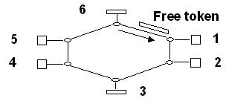
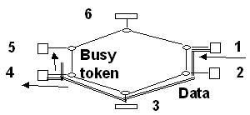
Token Ring
any node wishing to transmit a message must:
  wait until a Free token arrives:
  remove it, and send a Busy token plus message:

Slide 43
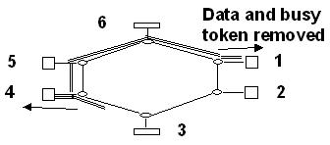
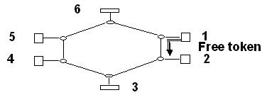
Token Ring
Tx station waits until the Busy token returns, then removes it and data
transmits a Free token
Notes:
after these four stages, the ring is back where it was, except the next node gets first chance to transmit
if the node that just transmitted want to send again immediately, it must wait until all others have had a chance

Slide 44
Token Ring
needs mechanisms to set up and maintain the token
these mechanisms must be
  either centralised (hence single-point-of-failure)
  or distributed (more complex, more expensive)
Notes:
how does the token get there in the first place?
and how does it get replaced if it gets lost?
some rings have a special monitor node that restores the token if something goes wrong
others share this duty among all stations (needs a clever scheme to avoid getting several replacement tokens!)
note that the only "wasted" activity is the circulation of the token, and when the ring is busy, this is a small proportion of total activity. I.e. busy token ring networks work efficiently (unlike busy CSMA/CD networks)

Slide 45
Token Ring
strengths:
  fairer and more efficient than CSMA/CD when traffic is heavy
  all nodes are guaranteed a chance to transmit within some fixed time
weaknesses:
  complexity
  delays awaiting the token
  Single point of failure (token – if token is missing everybody will be waiting)

Slide 46
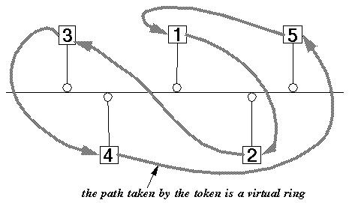
Token Bus
combines ring topology with bus topography
nodes form a virtual ring
a token circulates from node to node in sequence,
but is transmitted via the bus
Notes:
this is ingenious and sophisticated, and needs careful explanation
transmission occurs by broadcasting on a bus
but is arbitrated by passing a token around in a "virtual" ring, I.e. in an agreed sequence
hence CSMA/CD is not required, because only one node will transmit at a time

